Slide 1

Conditional Convergence and
Long-Run Economic Growth

Slide 2
Conditional Convergence in Practice
什么叫做“条件收敛”，或者叫做相对收敛？
  Growth rate of capital per worker, ∆k/k:
  ∆k/k= ϕ[ k(0) , k*] ,
(−) (+)
  即∆k/k的大小取决于k*/ k(0)的比值，或者两者之间的相对距离。

Slide 3
Conditional Convergence in Practice
y= A· f(k)
Growth rate of real GDP per worker is a function of initial and steady-state real GDP per worker.
∆y/y= ϕ[ y(0) , y*]
(−) (+)

Slide 4
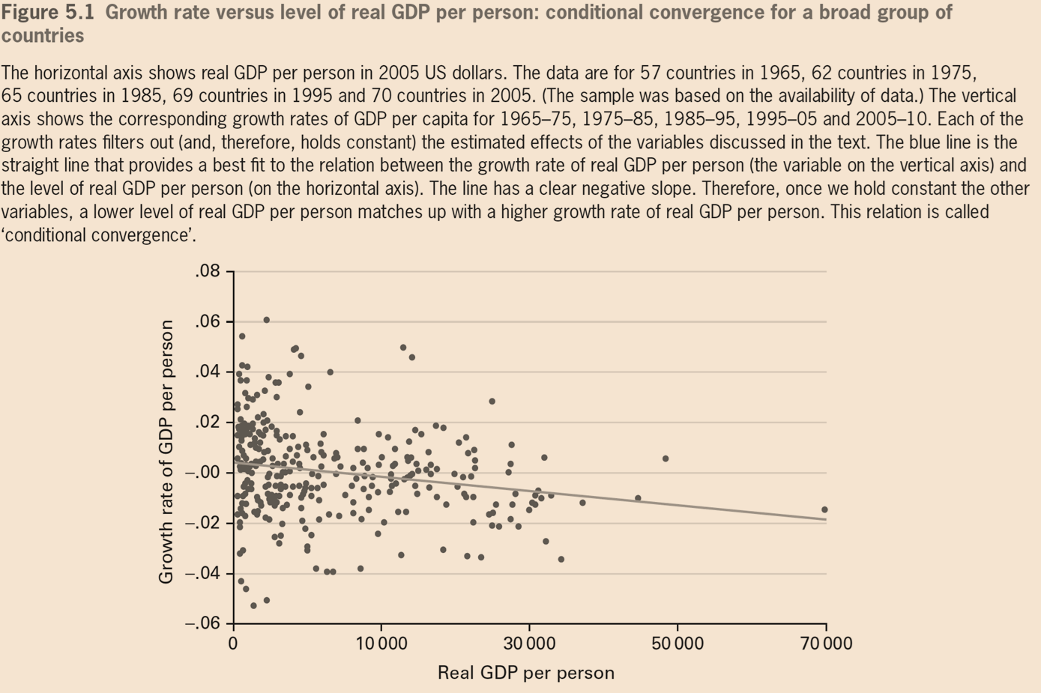

Slide 5
Conditional Convergence in Practice
Variables that influence y* that are held constant.
  The saving rate （s）
  The fertility rate (n)
  Technology level (A) determines productivity
  Others also influence economy’s productivity
    maintenance of the rule of law and democracy（民主法治）
    The government efficiency（政府效率，有为政府）
    The extent of international openness, measured by the volume of exports and imports (对外开放程度)
    Changes in the terms of trade(对外开放条件)
    Measures of investment in education and health （创新基础）
    The stable rate of inflation (价格稳定，市场作用)

Slide 6
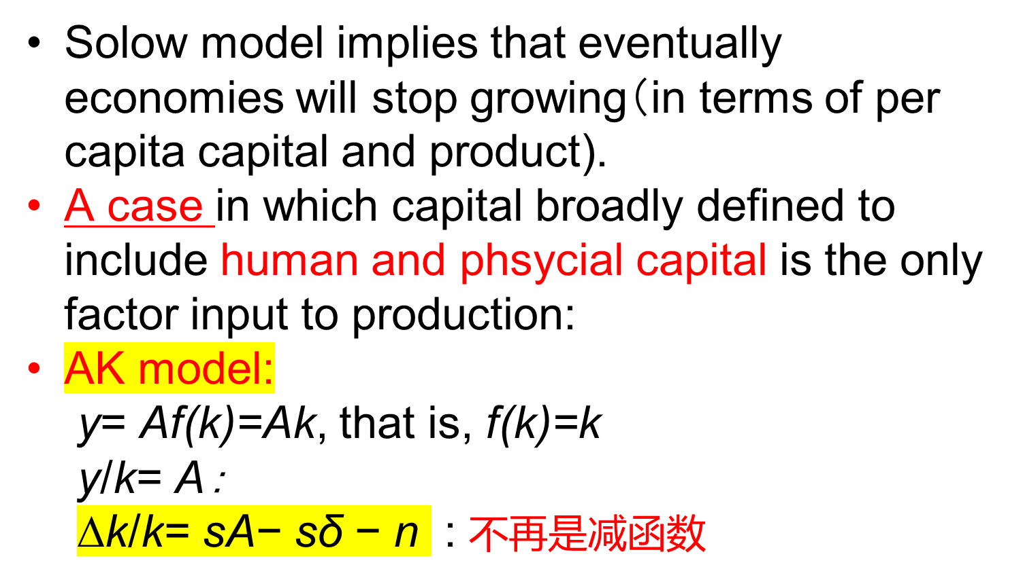
Long-Run Economic Growth

Slide 7
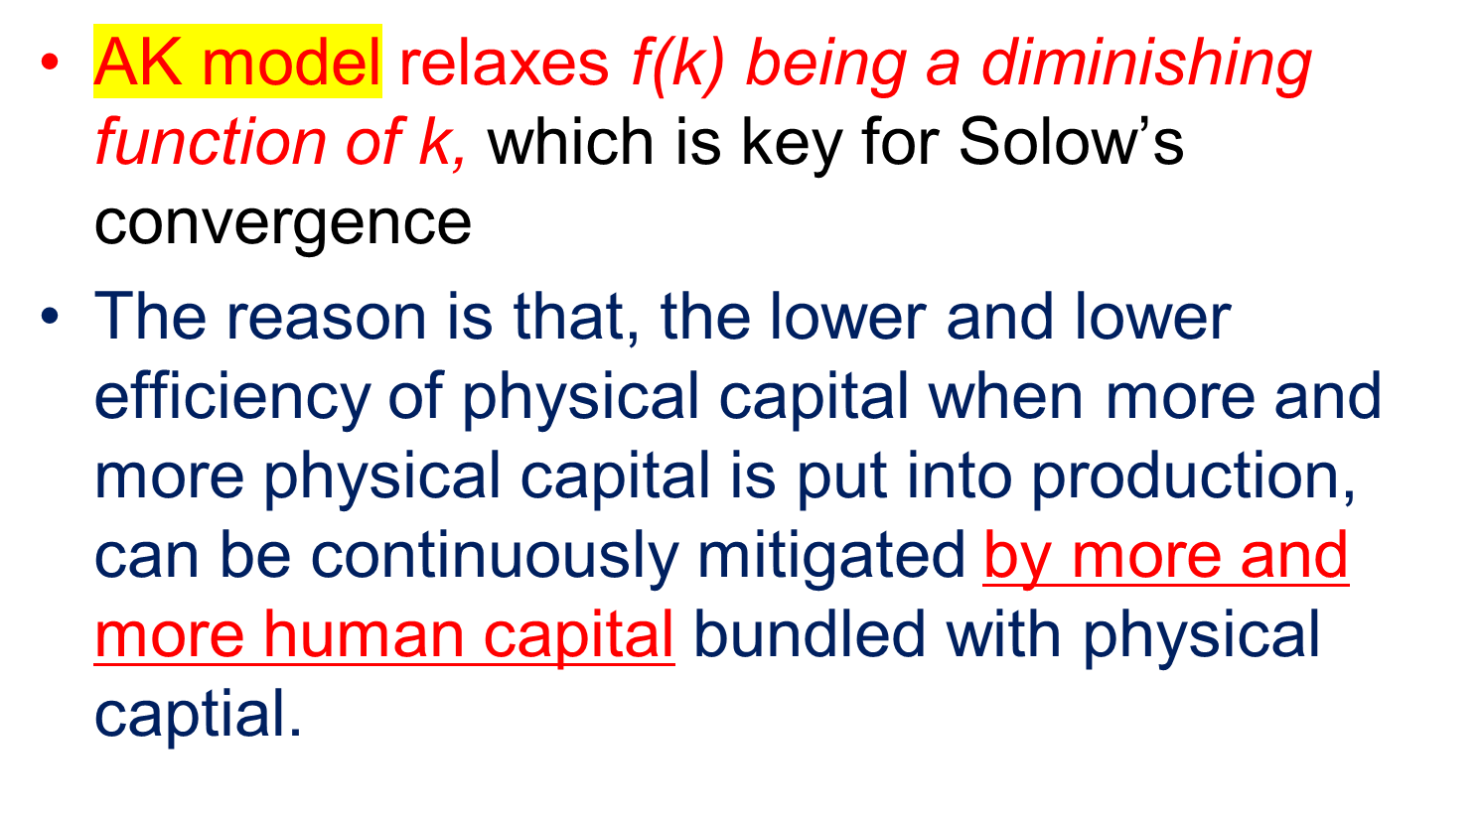
Long-Run Economic Growth

Slide 8
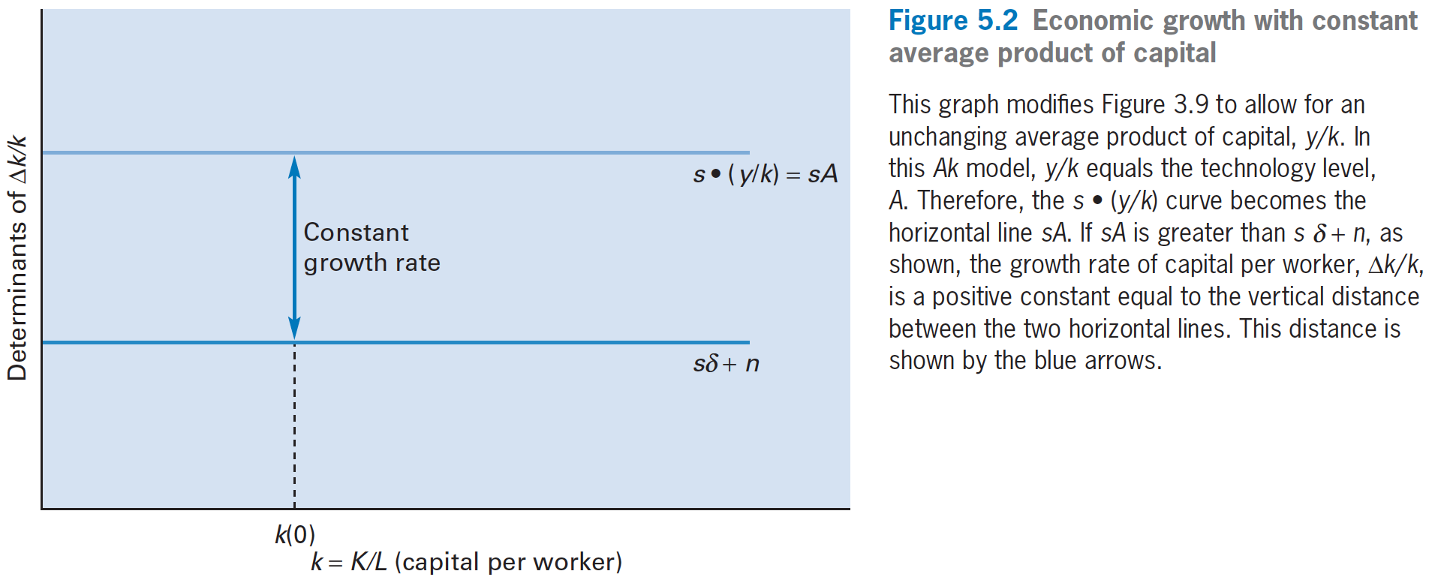
Long-Run Economic Growth

Slide 9
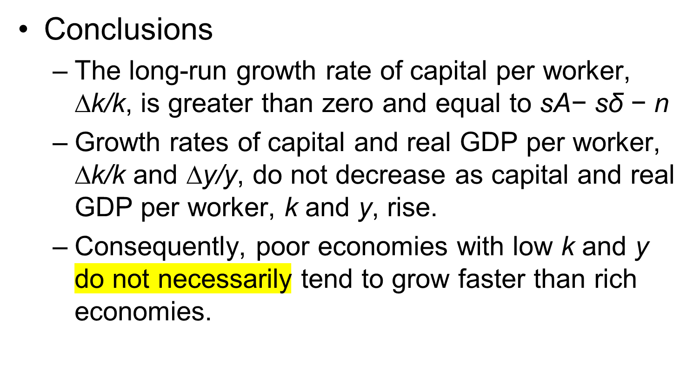
Long-Run Economic Growth

Slide 10
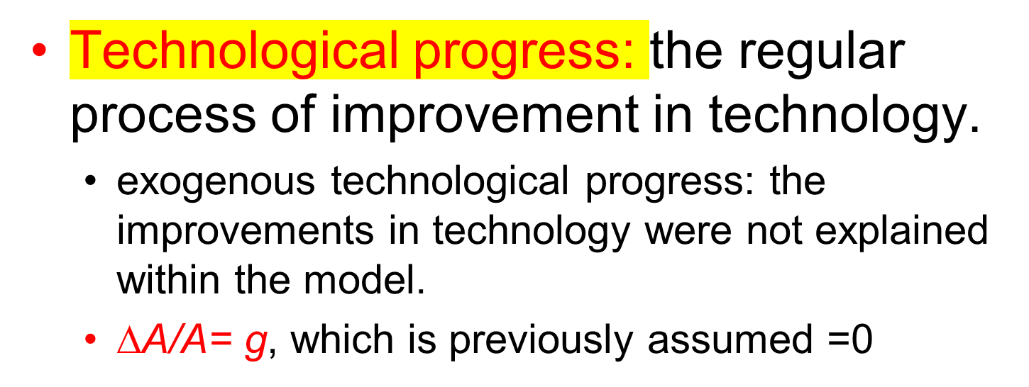
Long-Run Economic Growth

Slide 11
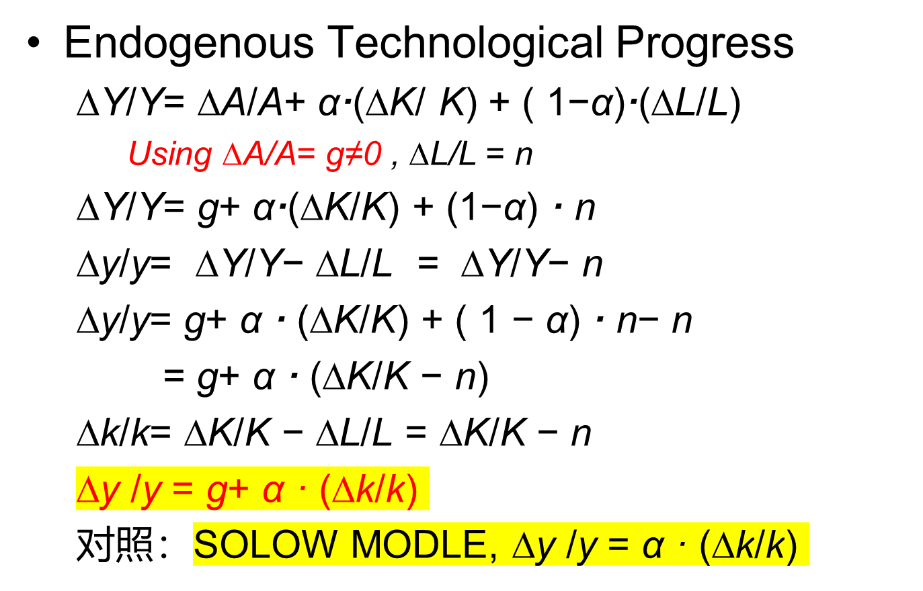
Long-Run Economic Growth

Slide 12
Long-Run Economic Growth
∆k/k previously in the Solow model:
  ∆k/k= sA·f(k)/k− sδ − n
Growth rate of real GDP per worker with endogenous technical progress
  ∆y/y= g+α·[ sA· f(k)/k− sδ − n]
之前y/k=A·f(k)/k, 当k 增加的时候，y/k 越来越小（因为A是固定不变的常数），可以实现∆k/k =0（长期均衡状态下）。

Slide 13
Long-Run Economic Growth
现在y/k=A·f( k)/k, 当k 增加的时候，y/k越来越小的趋势被抵消，因为A是不断增长的。
假定y/k在长期均衡状态下，可以保持不变（比如AK模型），则：(∆y/y)* = (∆k/k)* ≠0 (因为 y/k 是常数)
又因为：(∆y/y)* = g+ α·(∆k/k)*
所以：(∆y/y)* = g+ α·(∆y/y)*
(∆y/y)* − α·(∆y/y)* = g
( 1 − α)·(∆y/y)* = g
(∆y/y) * = g/(1 − α) ≠0
对照：Solow Model: g=0，so (∆y/y) * =0

Slide 14
Long-Run Economic Growth
Endogenous Technological Progress
  Steady-state growth rate with endogenous technological progress
    (∆y/y) * = g/(1 − α)
    Since 0 < α < 1，the steady-state growth rate of real GDP per worker, (∆y/y)∗, is greater than the rate of technological progress, g.

Slide 15
Long-Run Economic Growth
Endogenous Technological Progress
  (∆k/k)* = (∆y/y)*
  (∆k/k)* = g/(1 − α)
  Endogenous technological progress at the rate ∆A/A= g leads to long-term growth in real GDP and capital per worker, k and y, at the rate g/(1 − α).

Slide 16
Long-Run Economic Growth
Endogenous Technological Progress
  ∆k/k= s·(y/k) − sδ − n
  在长期均衡状态下(In steady-state growth)
  (∆k/k)* = g/(1 − α)
  所以长期均衡状态下：
  g/(1−α) = s· (y*/k*) − sδ − n
  ⟹ (y*/k*) = [sδ +n + g/(1−α)]/s: 常数保持不变，即资本生产力保持不变。
  对照：AK模型， y/k= A

Slide 17
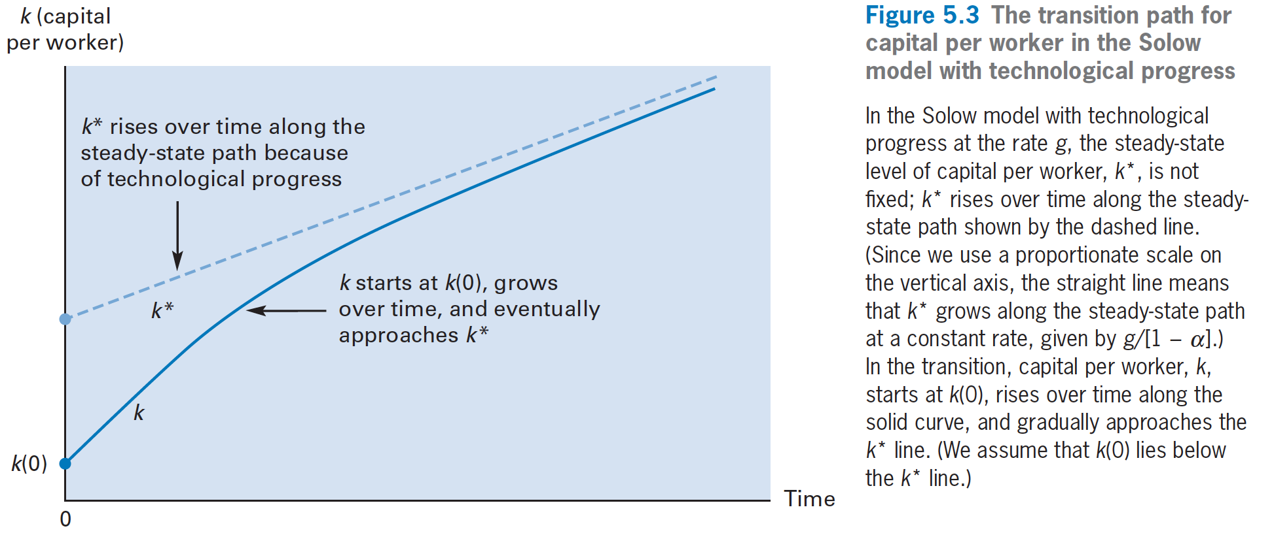
Long-Run Economic Growth

Slide 18
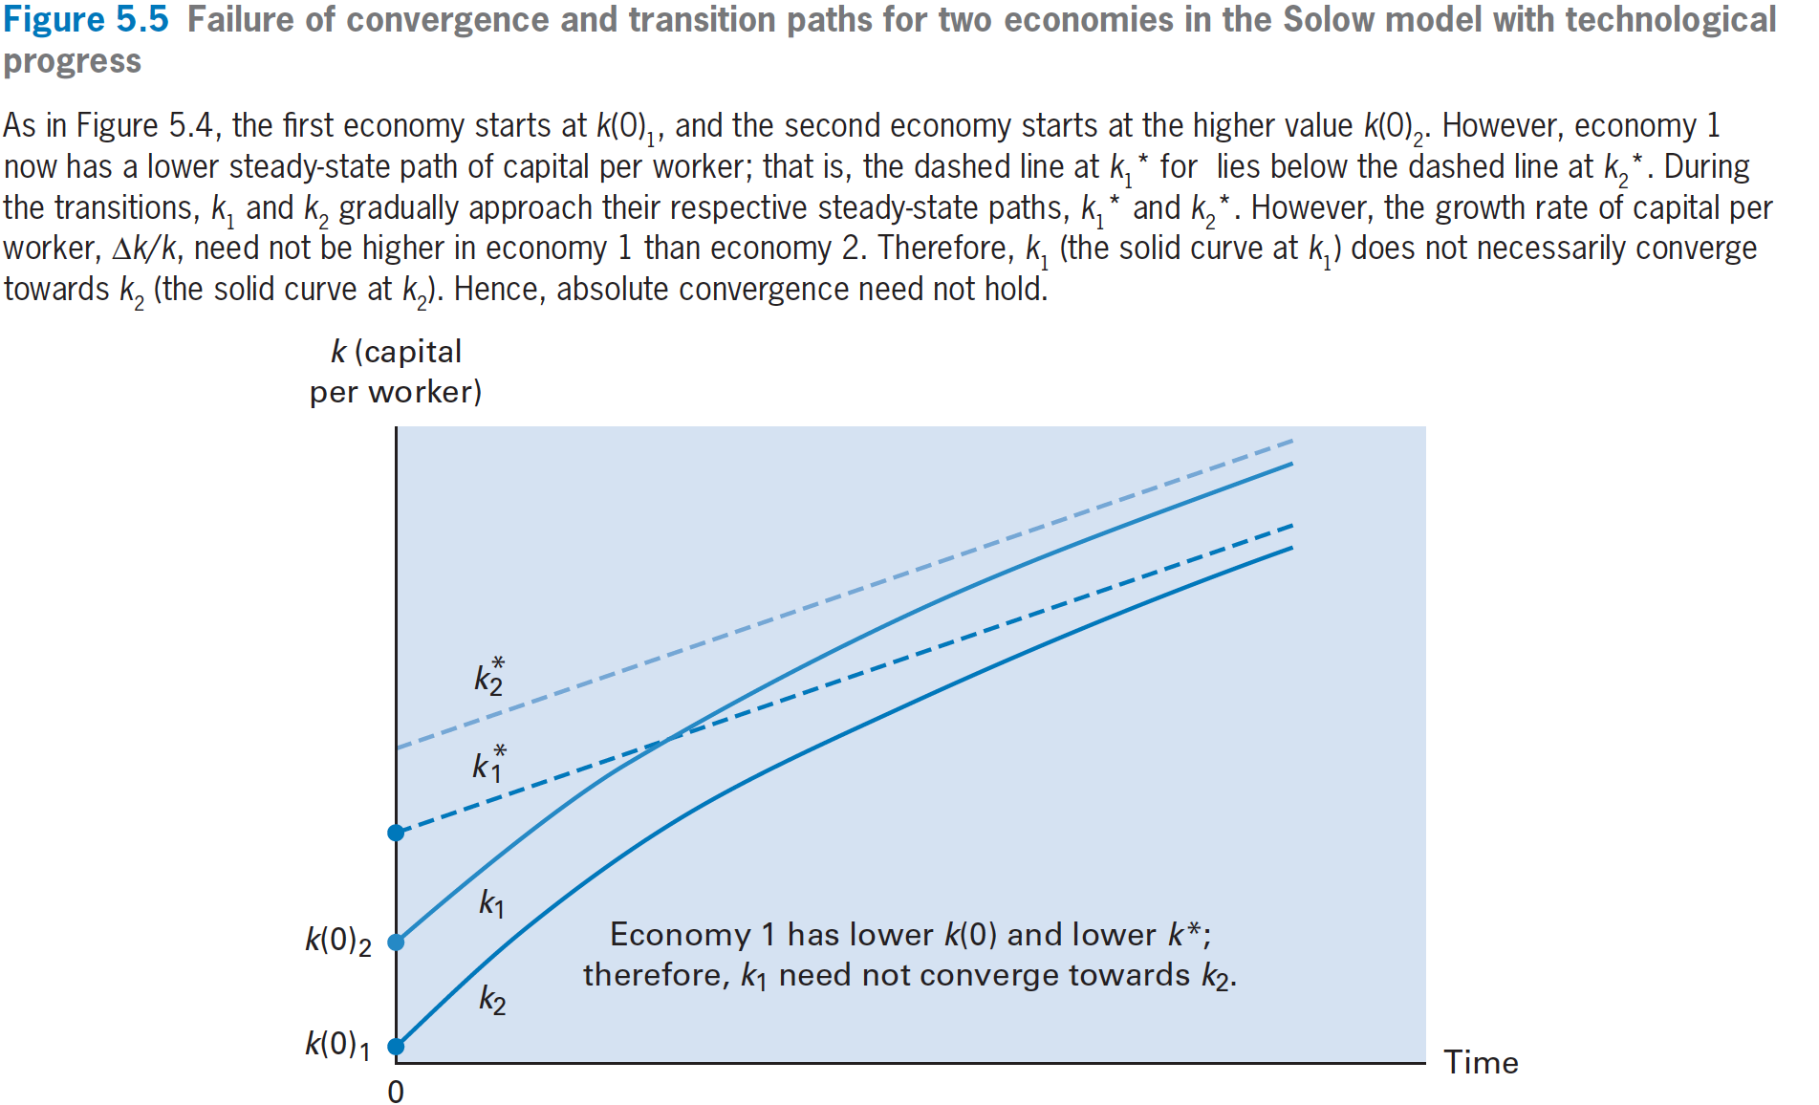

Slide 19
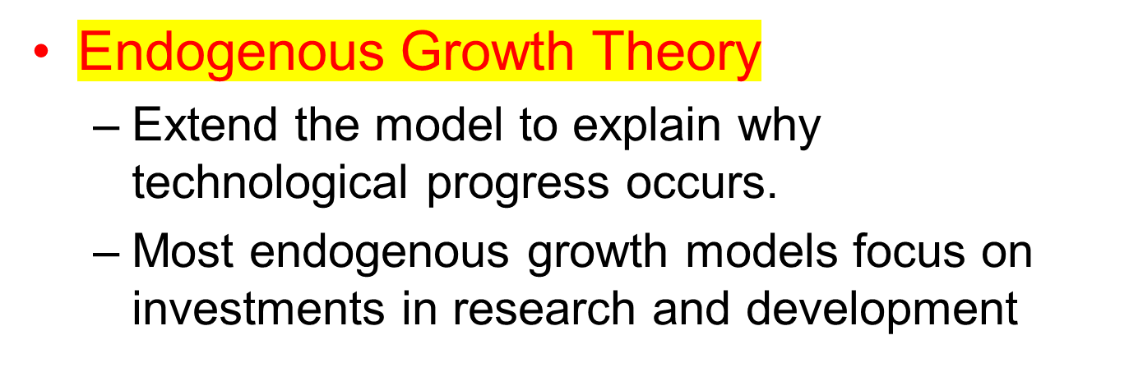
Long-Run Economic Growth

Slide 20
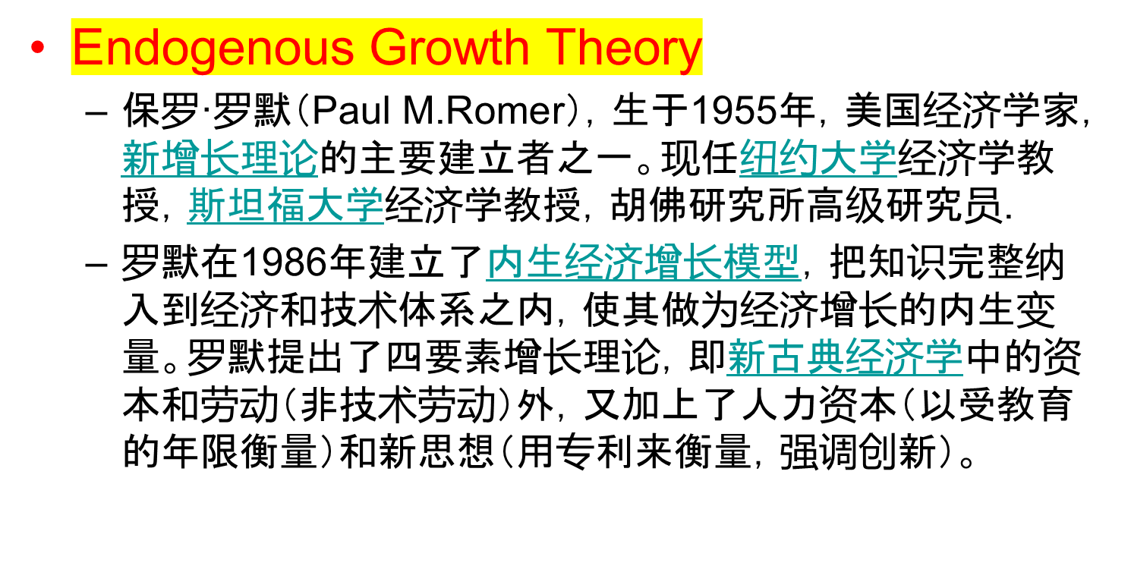
Long-Run Economic Growth

Slide 21
Long-Run Economic Growth
Endogenous Growth Theory
  The private return to R&D investment is higher if the costs of R&D are lower.
  The reward from successful innovations depends on how much they raise sales revenue or reduce production costs.
  The private return is higher if intellectual property rights over the use of an invention are more secure and long lasting.

Slide 22
Long-Run Economic Growth
  The Diffusion of Technology
    The imitation and adaptation of one country’s technology by another country.
    The rate of technological diffusion to a developing country is high when the country trades a lot with rich countries, has high education levels, and has well functioning legal and political systems.

